Slide 1


Recommendation Tools
Praveen Subramani
Bharanidharan Murugesan
Anais Mellas
May 2023

Slide 2

Table of Contents
Objective of Project
Data Preprocessing
Feature Engineering
Basetable Creation
Building Model
May 2023
Model Results

Slide 3
Objective of Project
Create Recommender System
To recommend ingredients to users by analyzing their previous recipe reviews.
Provide Top N ingredients
Along with matching recipes to allow users to substitute ingredients with relevant alternatives.
Suggest Healtier Alternatives
To the user based on nutritional value of ingredients

Slide 4
Data Preprocessing
Cleaning Reviews
Cleaning Ingredients
Removed Numerical Values & Punctuation Marks
Converted text to lowercase
Tokenised the text to individual words
Removed Stopwords & joined the remaining words to a string
Removed extra white spaces
Removed leading and trailing white spaces
Parsed a string representation of a list of ingredients
Then, removed any leading and trailing single quotes from each ingredient before returning the cleaned list.

Slide 5
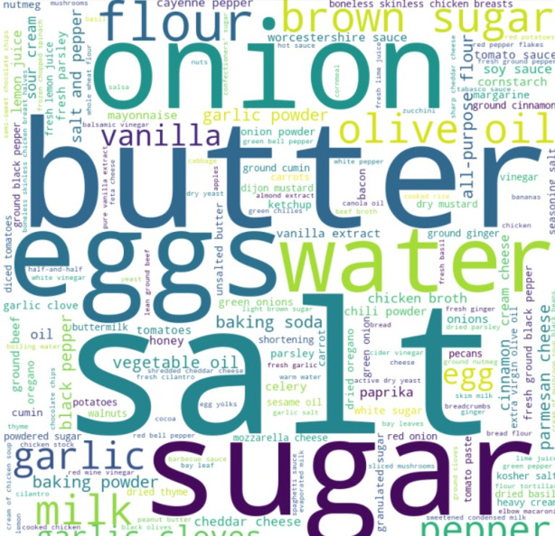
Feature Engineering
Grouped Similar Ingredients together
Nutrition data was split into separate columns,
Calories
Fat
Sugar
Sodium
Protein
Saturated fat
Carbs
To check if the ingredient is healthy

Slide 6
Basetable Creation
Criteria for Healthy Ingredient
Calories < 500
Fat < 15
Saturated fat < 15
Sugar < 30
Sodium < 15

Slide 7
Modeling
Five Models were used,
User-Based Collaborative Filtering (UBCF)
Item-Based Collaborative Filtering (IBCF)
Singular Value Decomposition (SVD) - Matrix Factorization
Alternating Least Squares (ALS) - Matrix Factorization
Co-Clustering

Slide 8
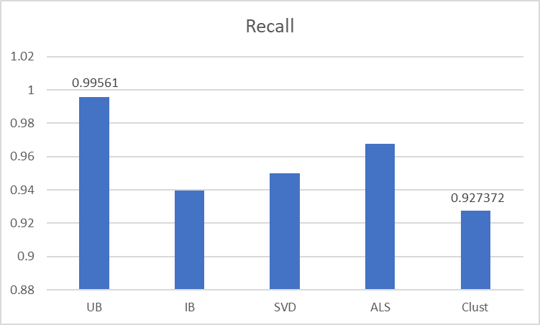
Modeling Results
A measure of completeness
User Based identifies most amount of positive instances
Co Clustering identifies least amount of the positive instances

Slide 9
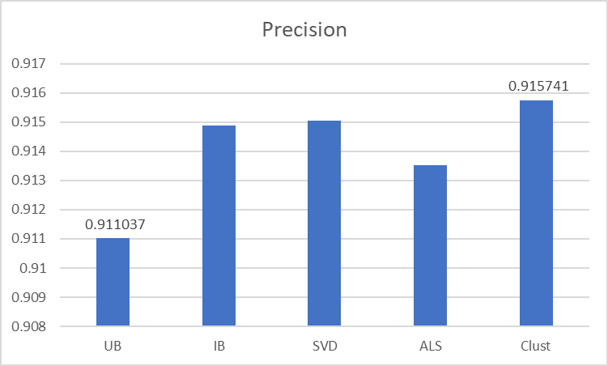
Modeling Results
A measure of exactness
UB identifies large proportion of predicted positives are negatives
Co Clustering identifies large proportion of predicted positives are true positives

Slide 10
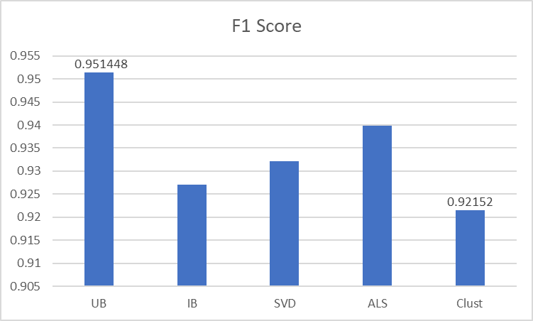
Modeling Results
Mean of Recall and Precision
User Based has the highest F1 Score and Co Clustering is the lowest
Since the Recall difference between both models was high whereas for Precision, the difference was marginal

Slide 11
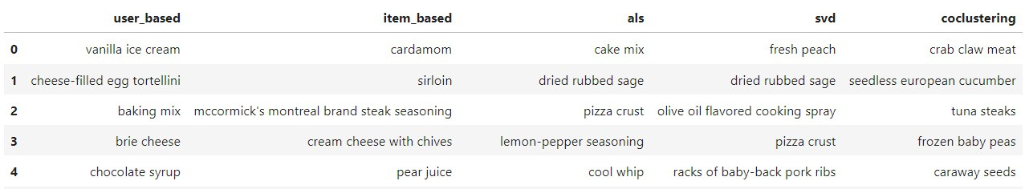
Top 5 Ingredients
For the User, U6596064

Slide 12
Recommendations
For the User, U6596064
Unhealthy Ingredients
Healthier Alternatives
Soya Sauce
Smoked Sausage
Mascarpone Cheese
Gingerroot
Frozen Orange Juice Concentrate
Lemon Wedges
Pumpkin Puree
Lime Zest
Red Beans
Red Pepper Flakes
Tomato Paste
Cream Chesse Frosting

Slide 13


Thank you
For your attention

